Slide 1
NEWMA: a new method for scalable model-free online change point detection
N. Keriven¹, D. Garreau², I. Poli³
¹Ecole Normale Supérieure, Paris (CFM-ENS chair)
²Max Plank Institute, Tuebingen
³LightOn, Paris
Séminaire SPOC, Dijon, June 27th 2018

Slide 2
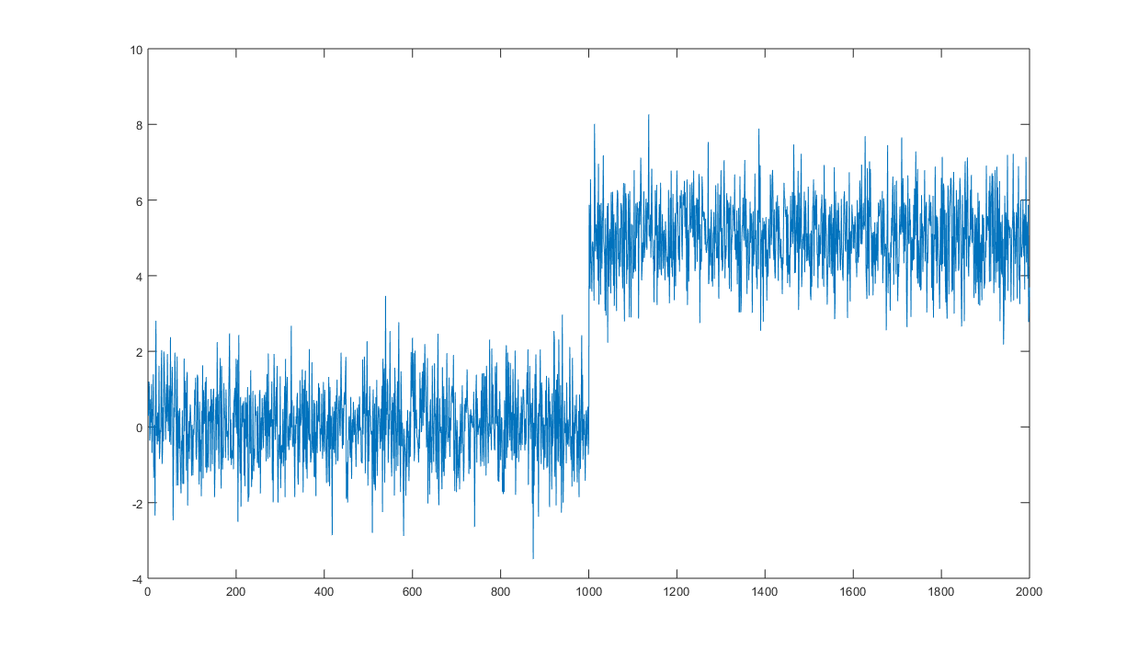
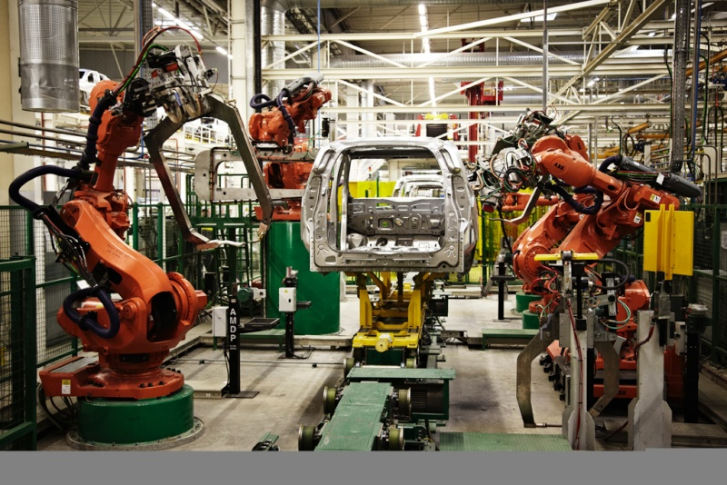
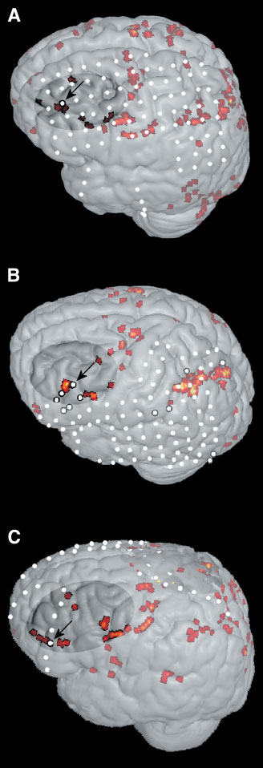
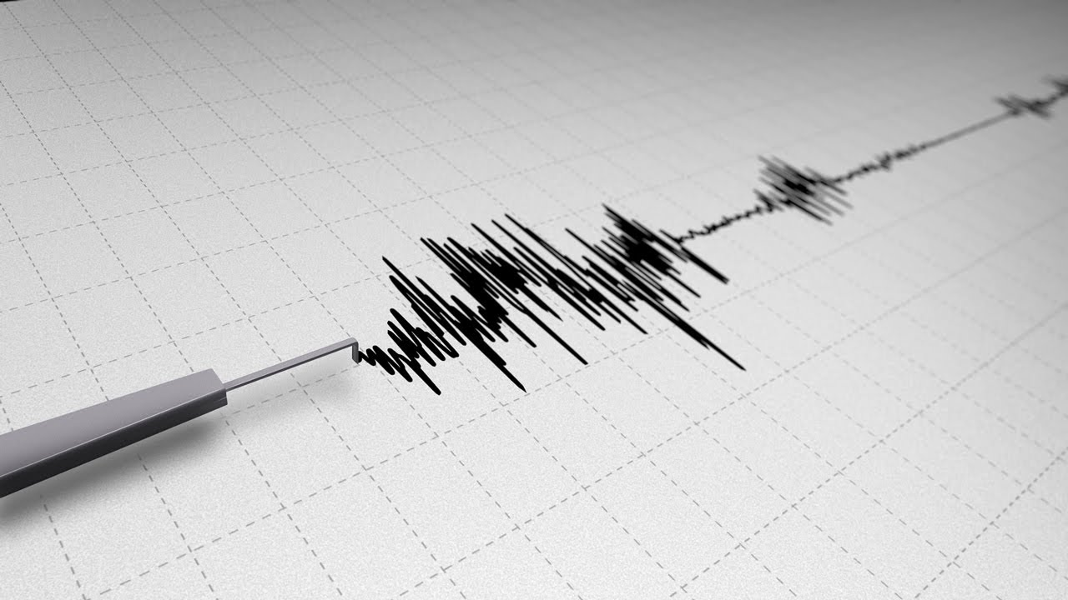
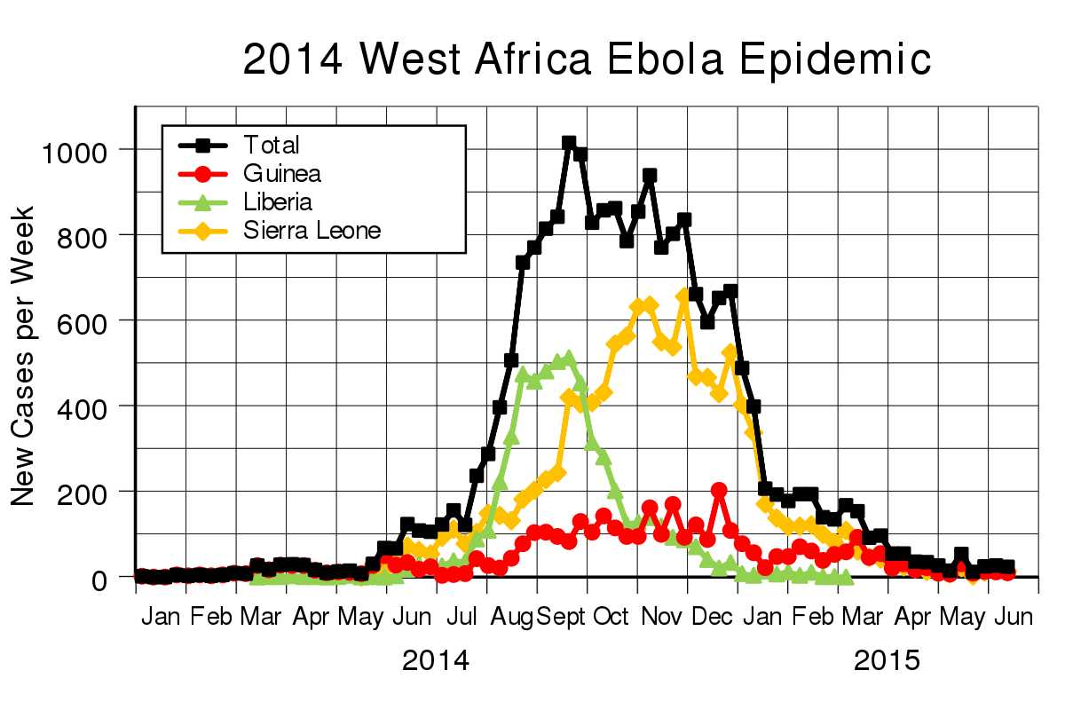
Change Point Detection
Goal:
Detect « changes » in a multivariate time series in an online fashion.
Long history of applications in:
Change point
Brain activity detection
Network intrusion
Fault detection in engineering systems
Seismic detection
Epidemic outbreaks…
Basseville, Tartakovsky. Detection of abrupt changes. 1993

Slide 3
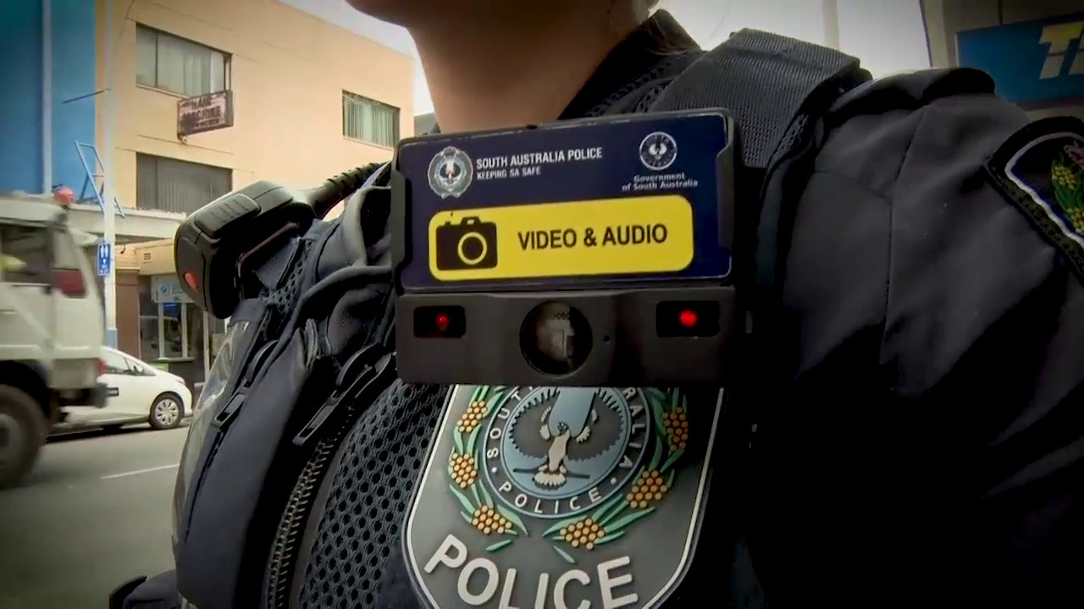
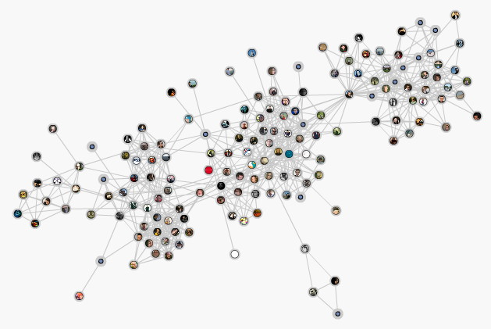
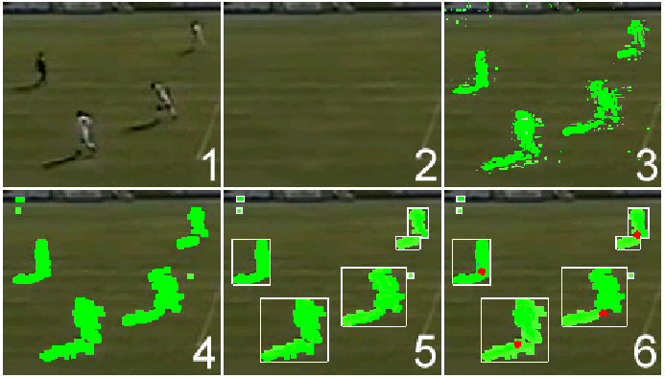
Modern challenge: scalability, sensitive data
Modern data ?
Heavy in memory
Sensitive, collected by personal devices
Need for methods that:
Are light and fast
Do not store raw data (« truly » online)
Can be performed on embedded devices with low power and memory
Real-time

Slide 4
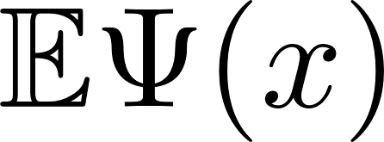
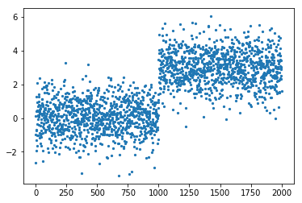
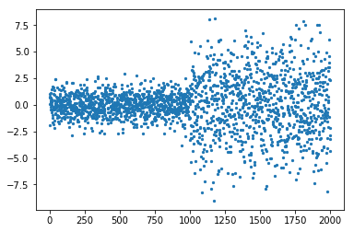
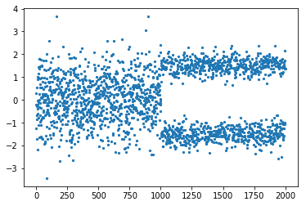
Framework
Time series
Goal: detect changes in some quantity where
Examples:
Mean:
Moment of order :
Histogram:
Coming: random nonlinearities…

Slide 5
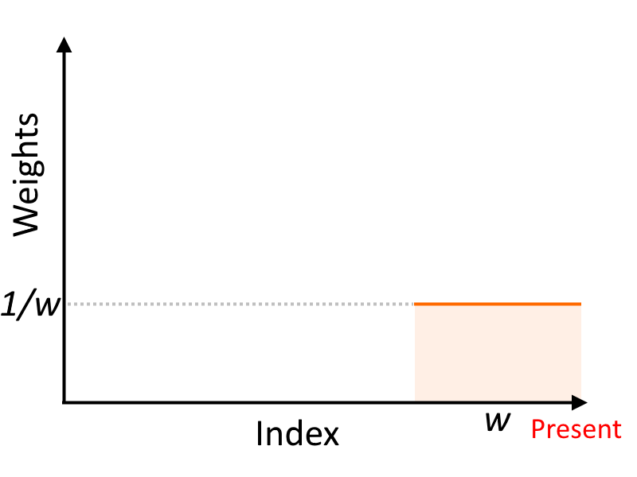
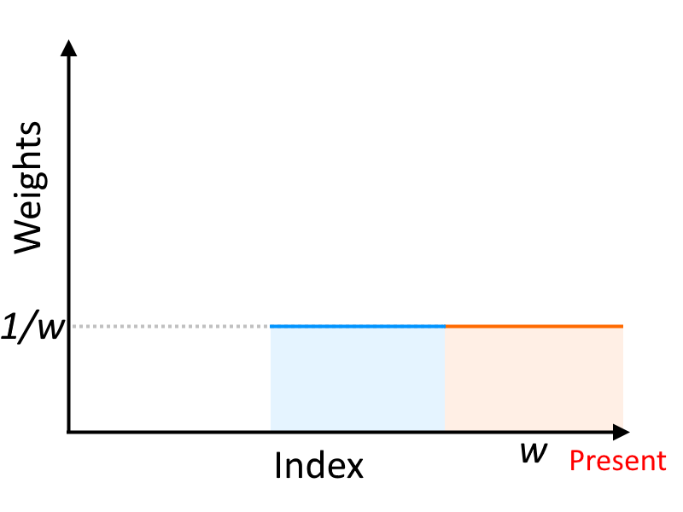
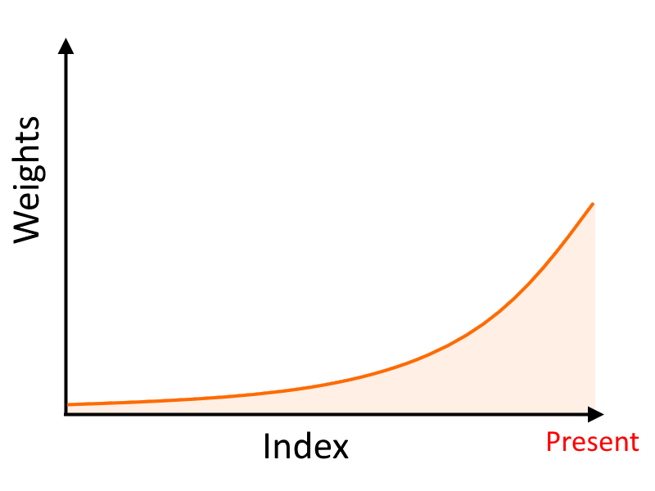
Context
Parametric: knowledge of « normal »
Non-parametric: « model-free »
Moving Average (MA)
« Scan » type algorithms
Alarm
Alarm
Prior knowledge
Store raw data
Exponentially Weighted Moving Average (EWMA)
Alarm
No prior knowledge
Store raw data
Prior knowledge
Store only weighted average
Proposed: NEWMA

Slide 6
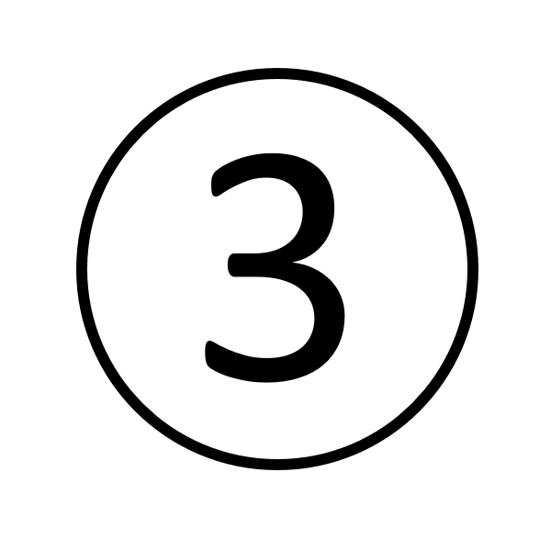
Outline
NEWMA: description & basic properties
Choice of mapping: random features
Experiments
Conclusion

Slide 7
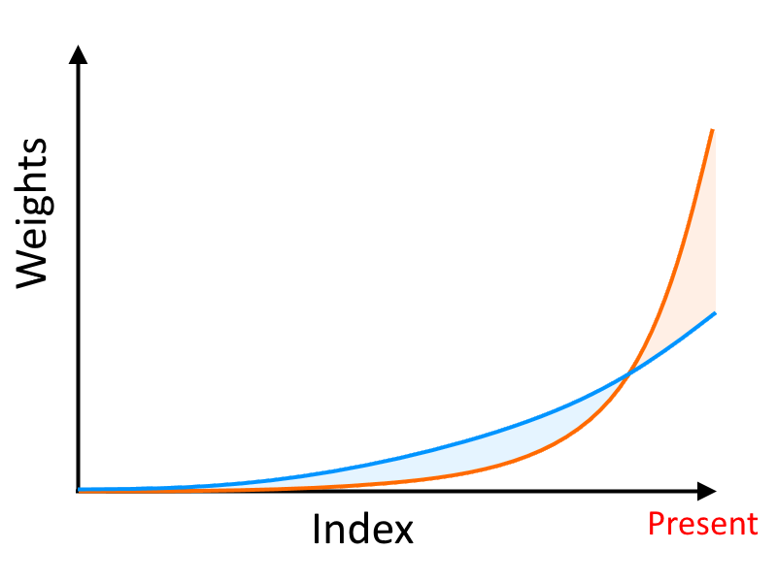
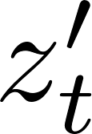
Proposed algorithm: NEWMA
EWMA
Scan
« No prior knowledge » EWMA: NEWMA
Idea:
compute two EWMAs with different forgetting factors
NEWMA compares implicitely old and new samples, without the need to explicitely store them
Alarm

Slide 8
Pseudo-metric & « pointwise » detection
Assumption:
Appropriate pseudo-metric:
Prop. : If bounded, and
Initialization
Window size
Concentration ineq.
Then, w.h.p.,
Prop. : If bounded, under the null, w.h.p.

Slide 9
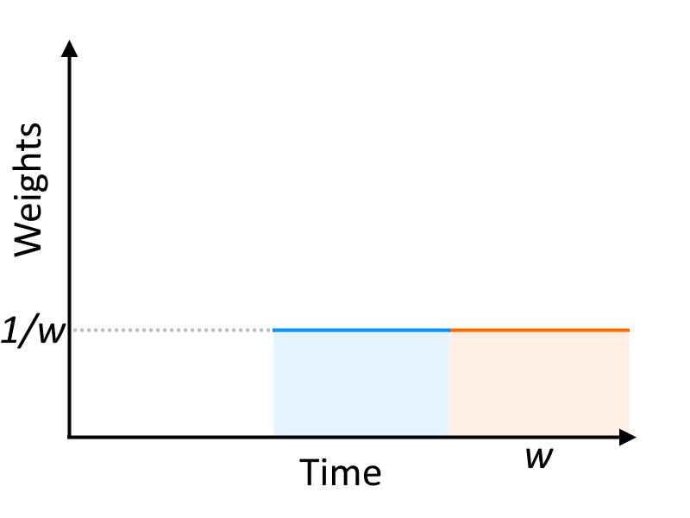
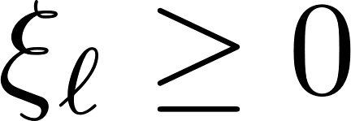
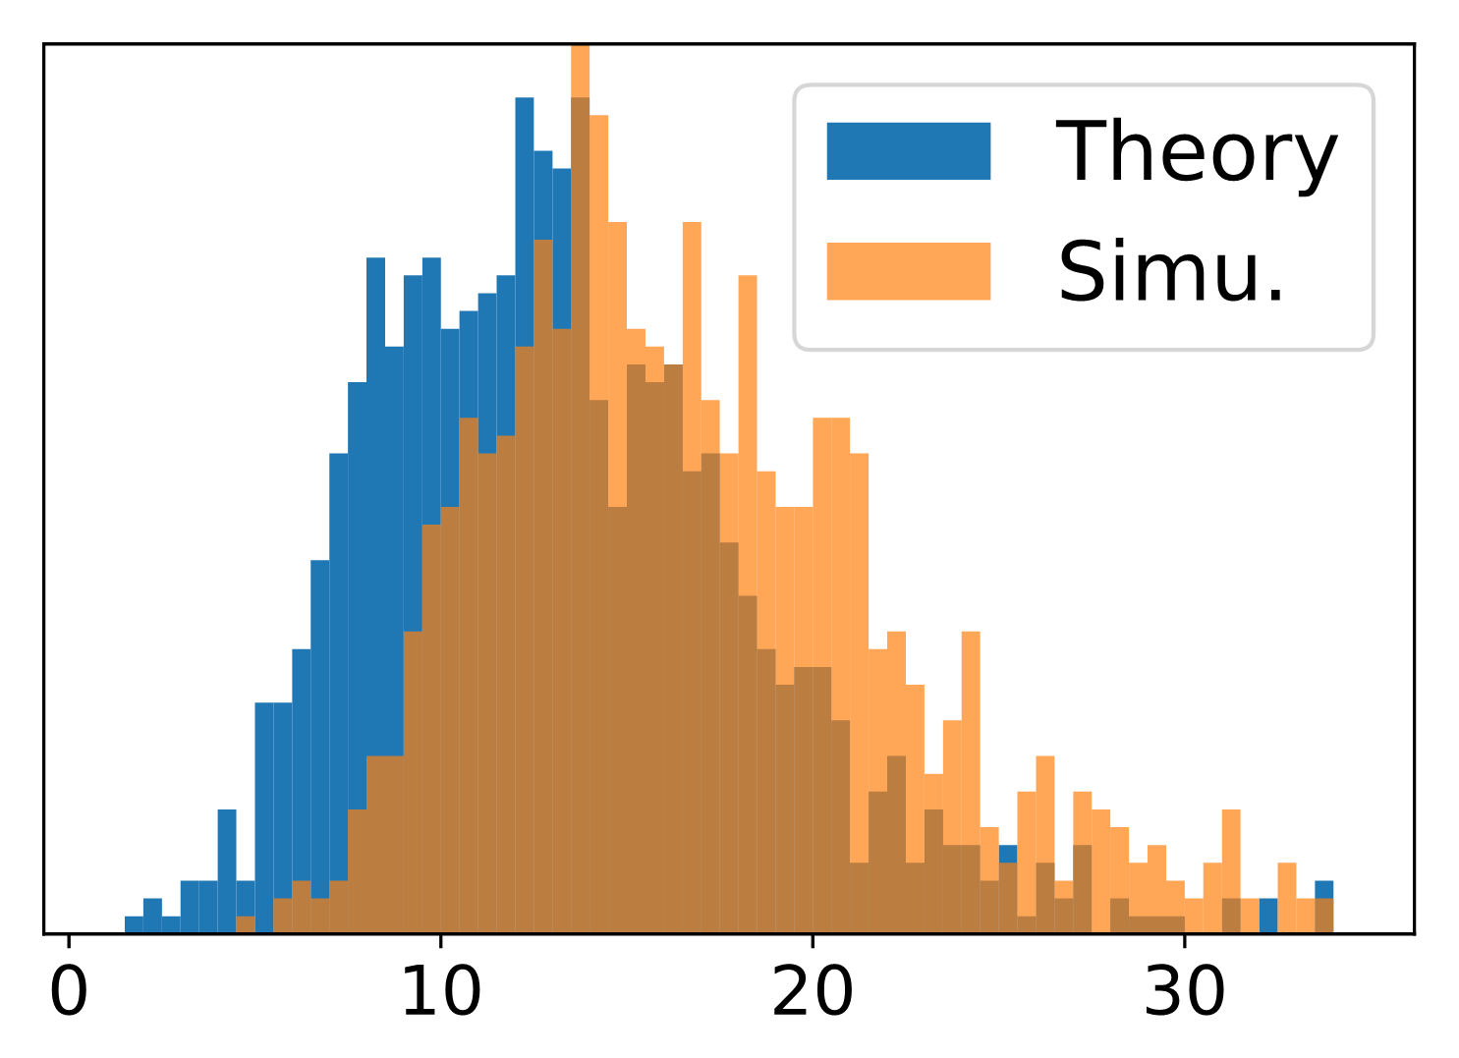
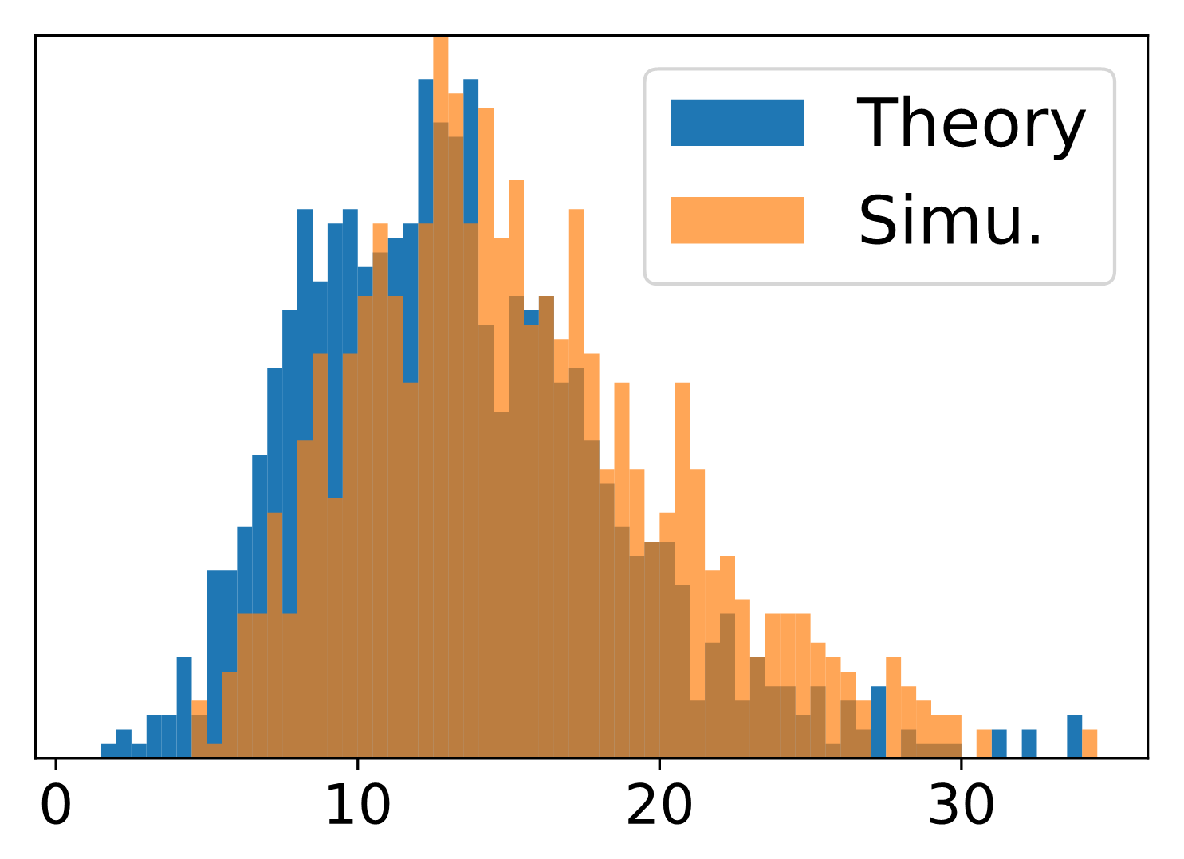
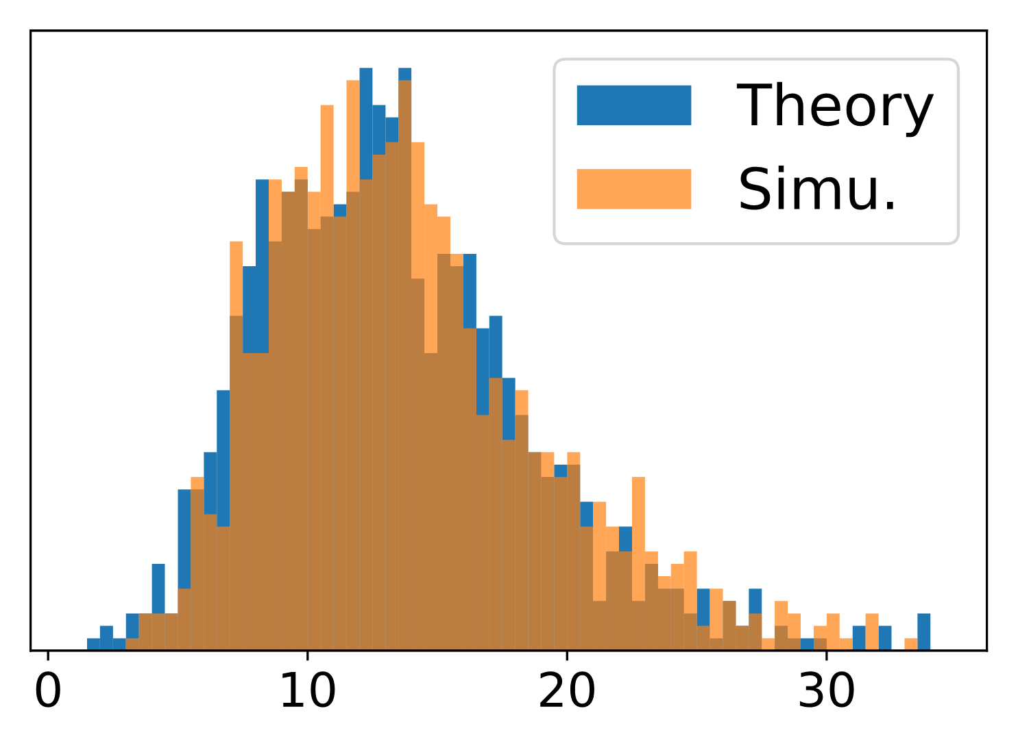
Asymptotic distribution under the null
Null hyp.: Assume all samples are drawn according to
Can we be more precise ?
We have seen : bounded small w.h.p.
Intuitively, for Scan algo:
Known
[Serfling 1980]
Thm. : assume , take
Mercer decomposition:
Known or estimated (future work)
Then

Slide 10
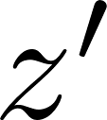
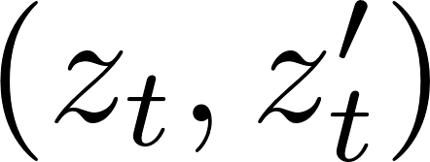
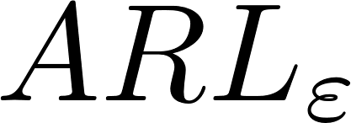
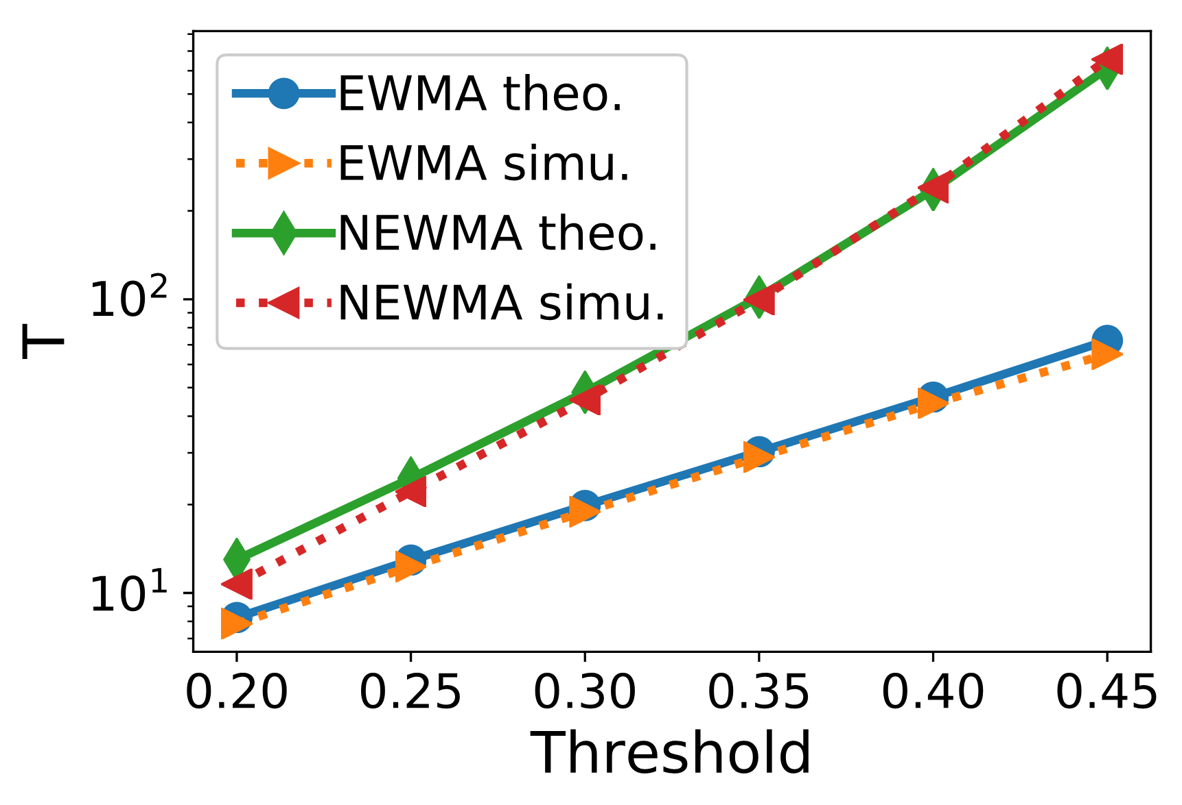
Average Run Length
Null hyp.: Assume all samples are drawn according to
In expectation, how long before a false alarm?
Markov-chain based approach for (1d) EWMA [Fu 2002]:
Adaptation for NEWMA
Markov
Hyp.: finite-dim
Markov-chain
Discretize the domain with prec.
Compute (easy)
Show
Useful insight, but limited usability in practice… (beyond toy examples)
Discretize ( - coverings), and - bound the domain
Compute
Show

Slide 11
Outline
NEWMA: description & basic properties
Choice of mapping: random features
Experiments
Conclusion

Slide 12
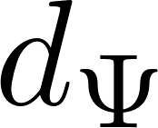
Good embedding ?
With no prior knowledge, which is « good » ?
Recall: pseudo-metric
and
Ideally, is a true metric:
Never true for finite-dimensional …
Def: MMD metric
Positive Definite kernel:
: Maximum Mean Discrepancy (MMD)
: RKHS associated to
[Gretton 2006, Borgwardt 2006]
Infinite-dimensional ! Not directly usable in practice…
Many usual kernels are characteristic:
Gaussian
Laplace
…
[Gretton 2006, Sriperumbudur 2010]:
true metric « characteristic »

Slide 13
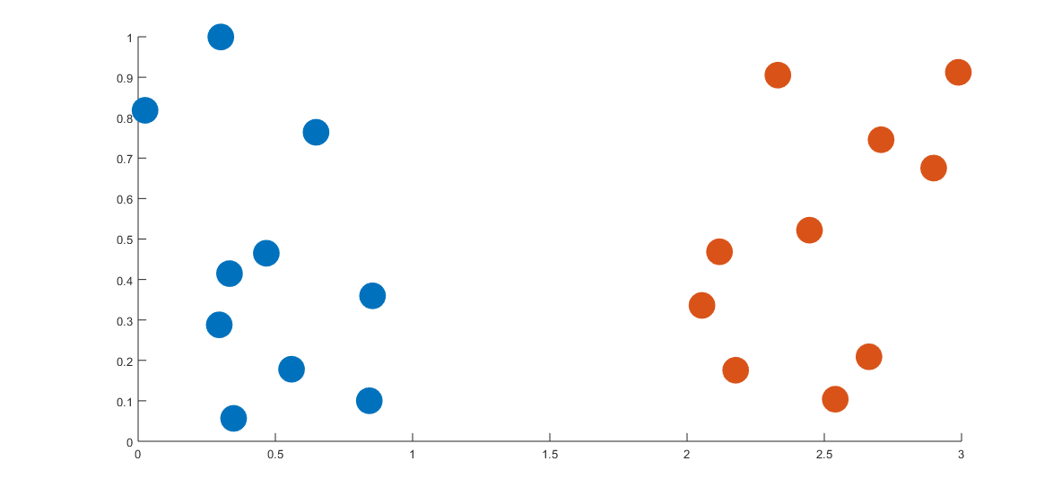
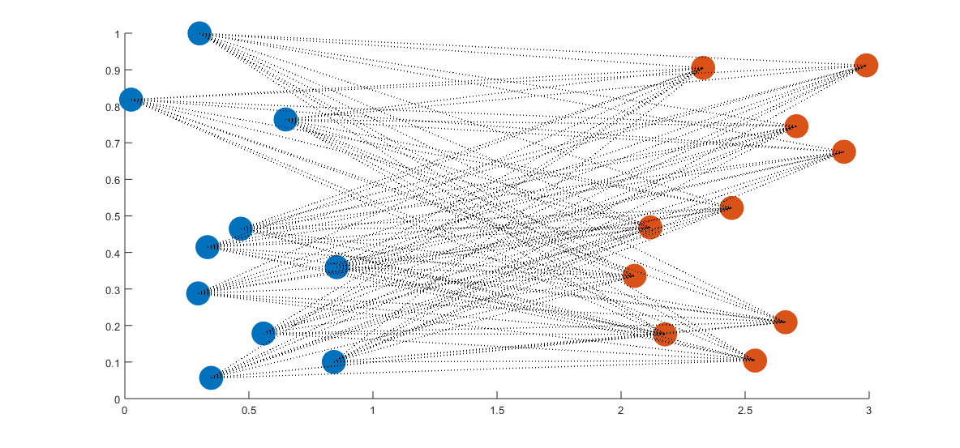
MMD and random features
Usual estimation of the MMD
Used in « Kernel Scan-B » algorithm
[Li 2015]
Compute MMD between windows of old and recent samples
Infeasible for NEWMA: no sample in memory = no kernel trick
Random features expansions of kernels [Rahimi 2007]
Hyp:
eg. any translation-invariant kernels:
w.h.p.:
Prop. : If
Then, w.h.p. on and ,

Slide 14
Outline
NEWMA: description & basic properties
Choice of mapping: random features
Experiments
Conclusion

Slide 15
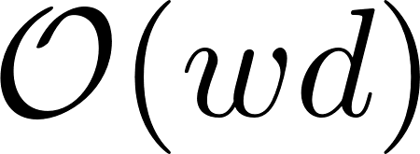
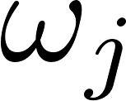
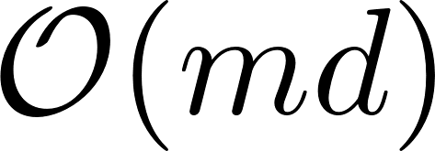
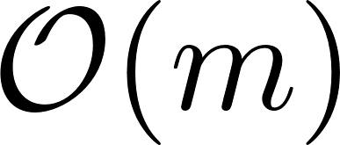
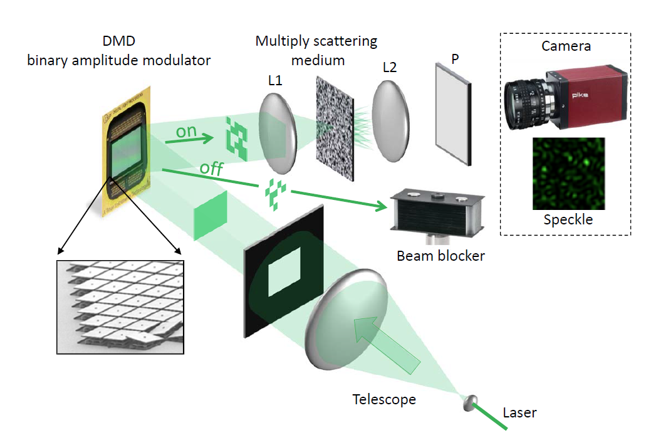
Algorithms
Compute MMD between windows of old and recent samples
Time (1 iter.)
Memory
Algorithms:
Kernel Scan-B [Li 2015]
NEWMA with:
Classical Random Fourier Features (NEWMA-RF)
« FastFood » Random Features [Le 2013] (NEWMA-FF)
Lighton’s Optical Random Features [Saade 2016]
(coming soon…)
Raw data
Dense matrix of
In practice, use of numerical procedure to dynamically adapt the threshold (see details in the paper)

Slide 16
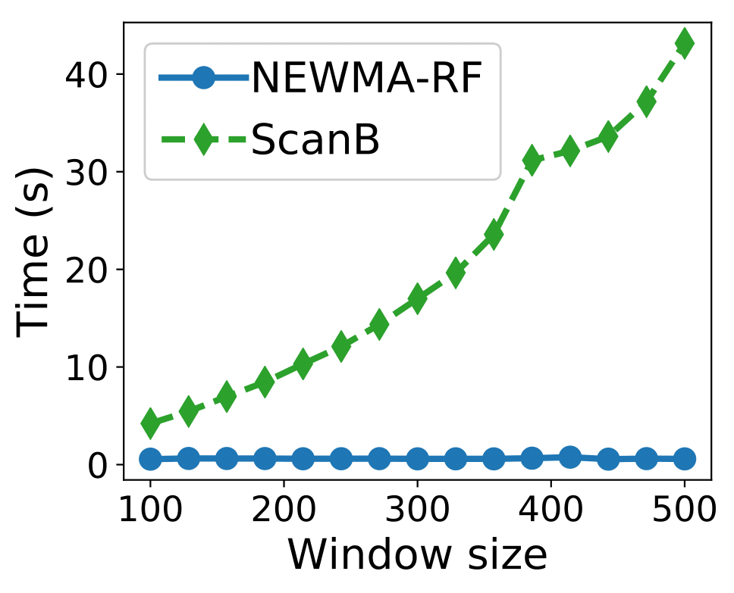
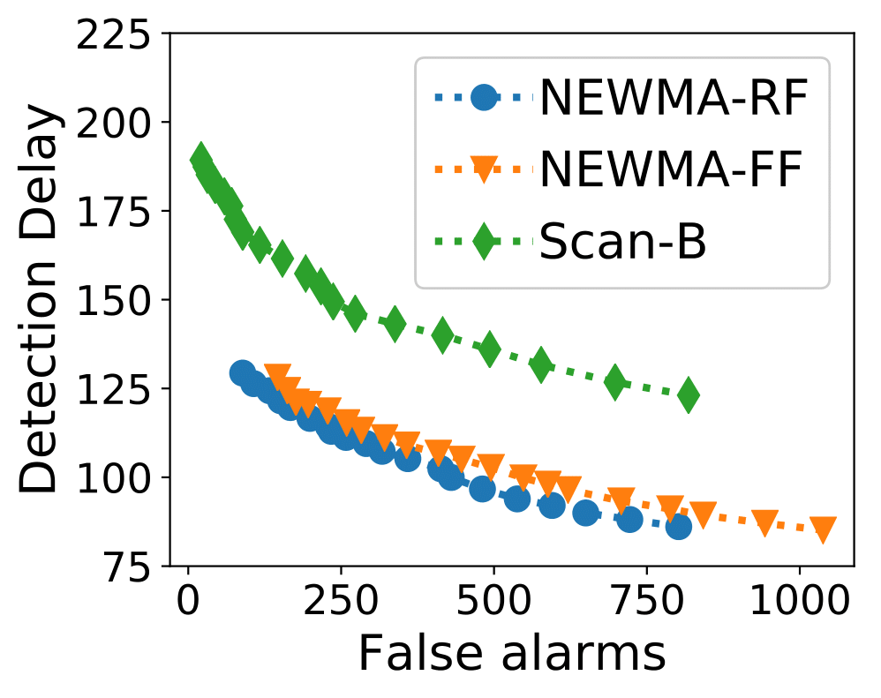
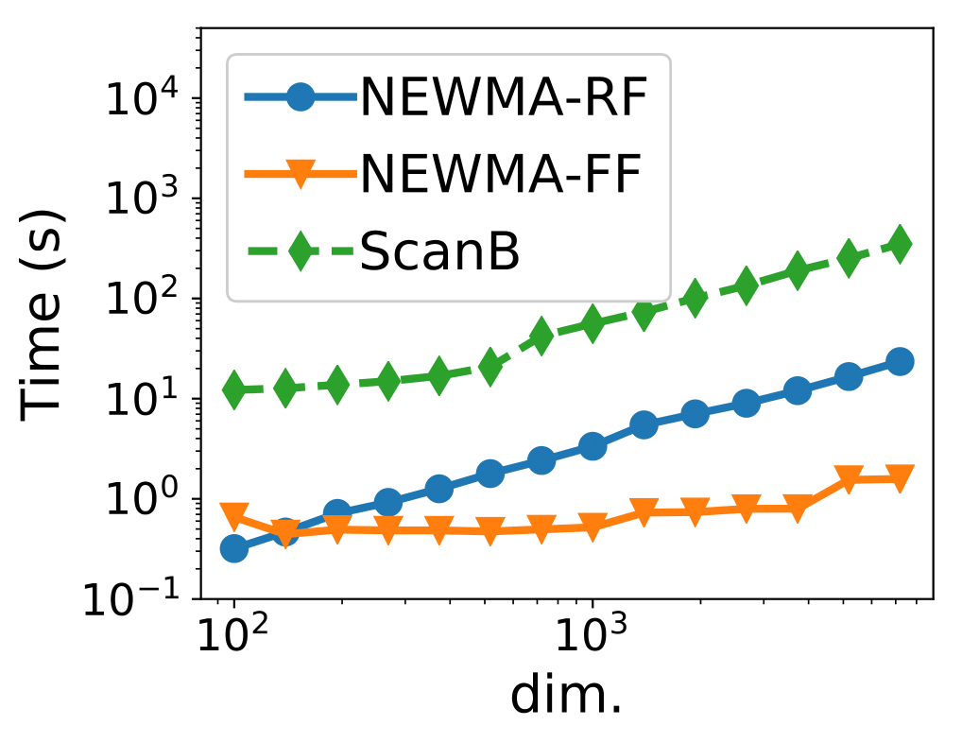
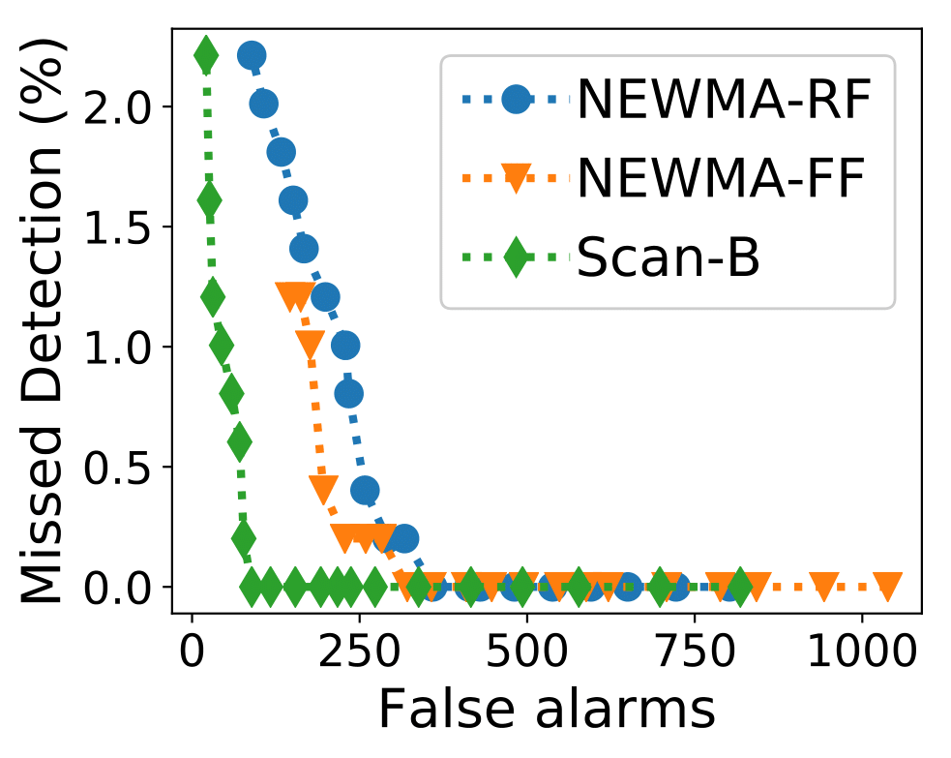
Synthetic Data
Data: GMM with 10 components
Time of execution:
Detection result (varying threshold, lower left best):

Slide 17
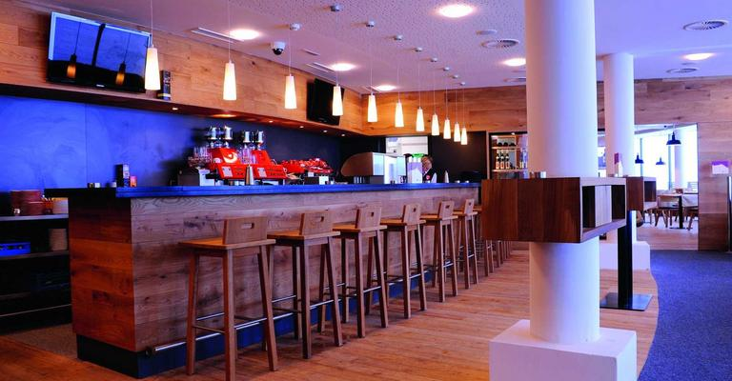
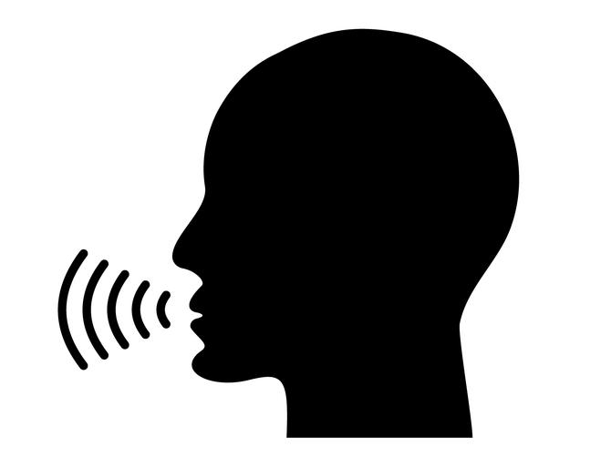
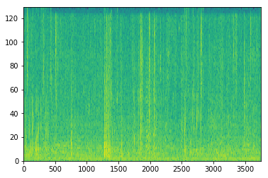
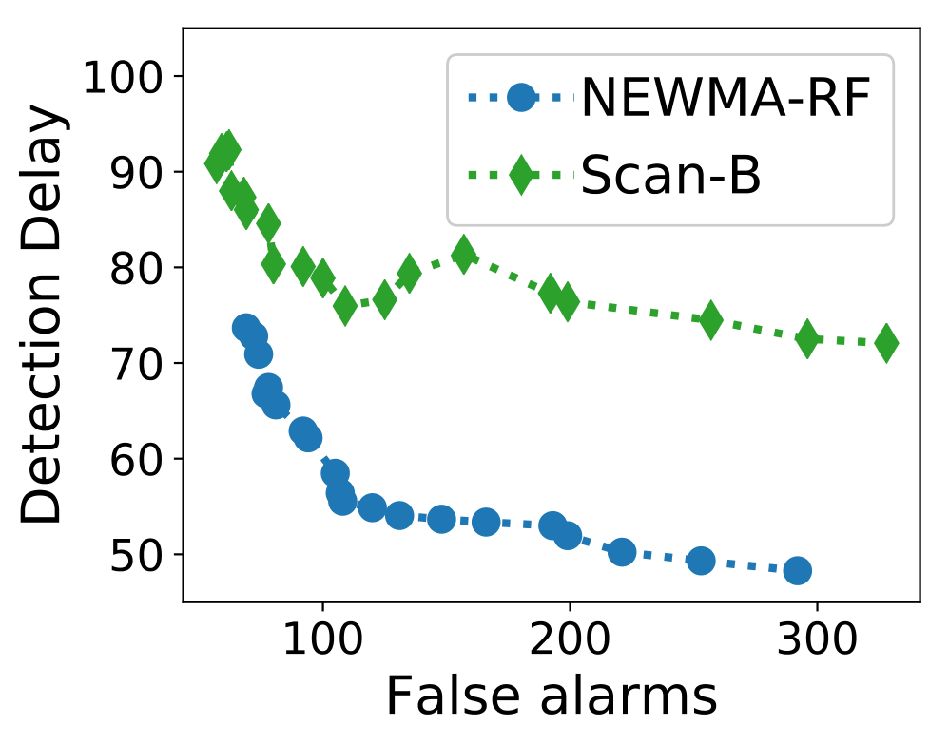
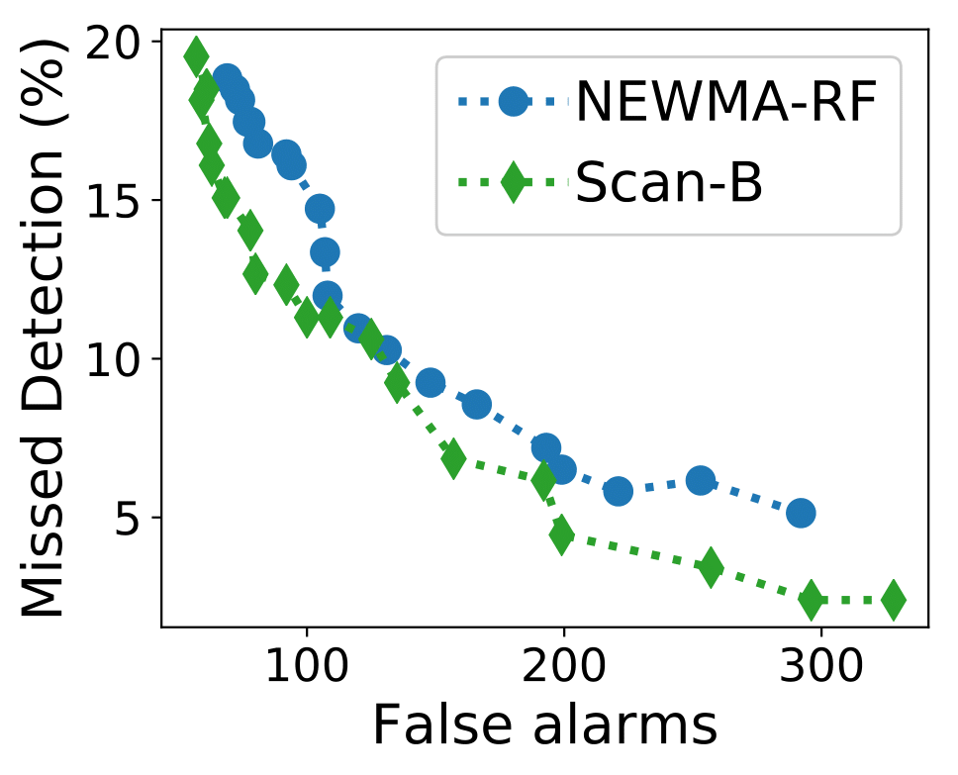
Voice activity detection
+
Short Time Fourier Transform
Change point detection

Slide 18
Video monitoring
Apply NEWMA on each block of pixels:
Real-time on a laptop, no GPU.
No need to record everything !

Slide 19
Outline
NEWMA: description & basic properties
Choice of mapping: random features
Experiments
Conclusion

Slide 20
Conclusion, outlooks
Introduced « No prior knowledge »-EWMA:
Simple but novel idea inspired by existing methods (EWMA and Scan algorithm)
Compare old and recent samples without storing them in memory
Faster than existing non-parametric methods
Addition of Random Features to use the MMD between distributions
Fast random features for sublinear cost in dimension
Outlooks:
Optical Random Features (very soon)
Application to other type of data: graph…
Non-iid data

Slide 21
Thank you !
Keriven, Garreau, Poli. NEWMA: a new method for scalable model-free online change-point detection. Submitted. arXiv:1805.08061
Code: github.com/lightonai/newma

